Slide 1
An Introduction to Parallel Programming
Peter Pacheco
Chapter 3
Distributed Memory Programming with
MPI
Copyright © 2010, Elsevier Inc. All rights Reserved
Notes:
The University of Adelaide, School of Computer Science
Chapter 2 — Instructions: Language of the Computer

Slide 2
Objectives
Understand Data Distribution
Serial Code and Parallel Addition
More Collective Communications
  Scatter
  Gather
  Allgather
  Barrier
  Wtime
Virtual BOX
10-<number>

Slide 3
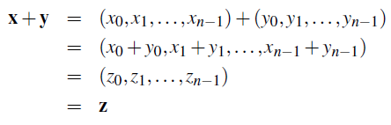
Data distributions
Compute a vector sum.
Copyright © 2010, Elsevier Inc. All rights Reserved

Slide 4
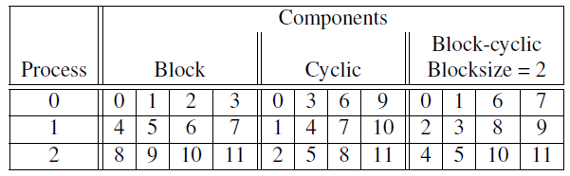
Different partitions of a 12-component vector among 3 processes
Copyright © 2010, Elsevier Inc. All rights Reserved

Slide 5
Partitioning options
Block partitioning
  Assign blocks of consecutive components to each process.
Cyclic partitioning
  Assign components in a round robin fashion.
Block-cyclic partitioning
  Use a cyclic distribution of blocks of components.
Copyright © 2010, Elsevier Inc. All rights Reserved

Slide 6
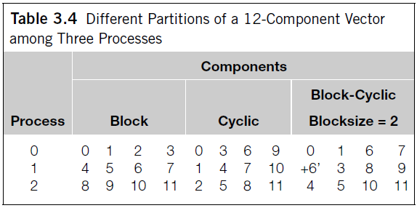
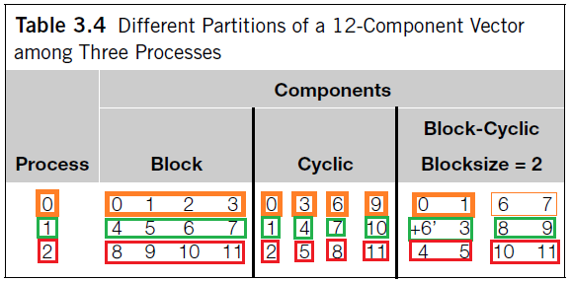
3.4.6 DATA DISTRIBUTIONS
Definitions for each one:
Pag 110.
OR next slide
Copyright © 2010, Elsevier Inc. All rights Reserved

Slide 7
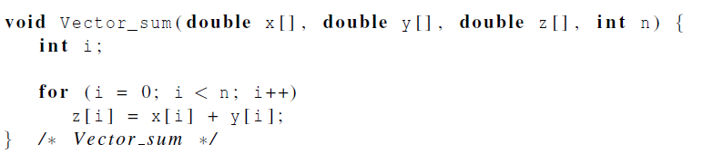
Serial implementation of vector addition
Copyright © 2010, Elsevier Inc. All rights Reserved

Slide 8
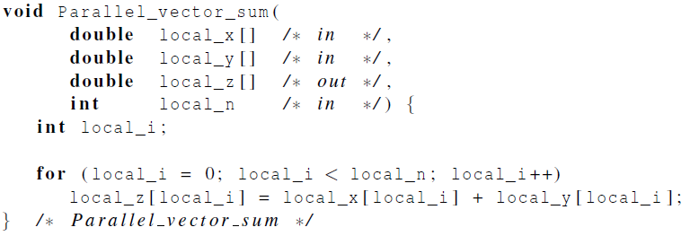
Parallel implementation of vector addition
Copyright © 2010, Elsevier Inc. All rights Reserved

Slide 9
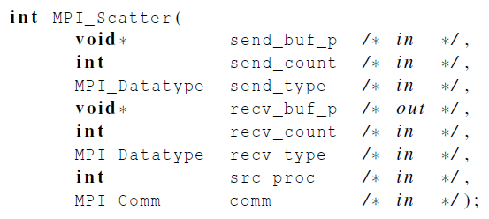
Scatter
MPI_Scatter can be used in a function that reads in an entire vector on process 0 but only sends the needed components to each of the other processes.
Copyright © 2010, Elsevier Inc. All rights Reserved

Slide 10
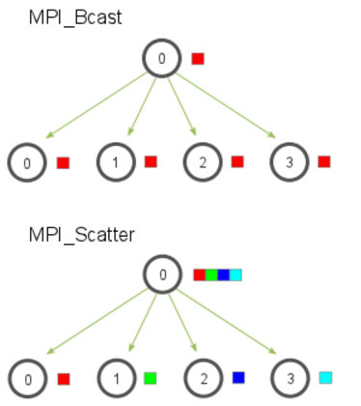
Scatter (visual explanation)
Similar BUT not the same as BCAST
Copyright © 2010, Elsevier Inc. All rights Reserved

Slide 11

Scatter
Sends the 1st block of send_count objects to P0
The next block of send_count objects to P1
And so on
This will work well and directly only if:
  You use block distribution AND
  The number of elements is evenly divisible by comm_sz
So what about other types of distribution?
  Students:
  Exercise 18 (Cyclic, Block-Cyclic)
  Exercise 3.13 (n) not evenly divisible by comm_sz
Copyright © 2010, Elsevier Inc. All rights Reserved

Slide 12
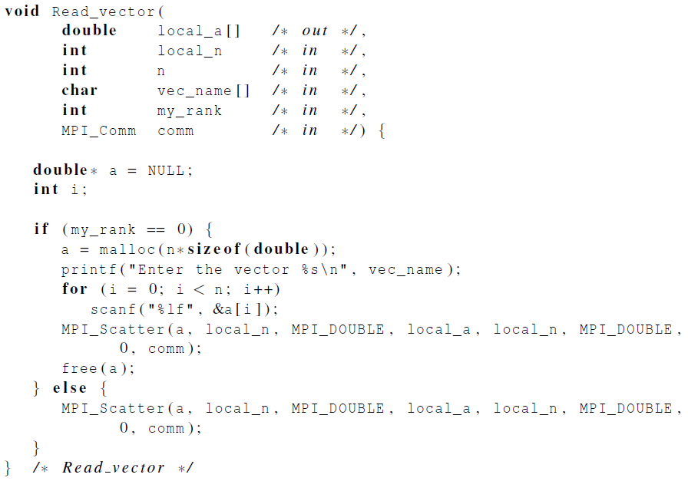
Reading and distributing a vector
Copyright © 2010, Elsevier Inc. All rights Reserved

Slide 13
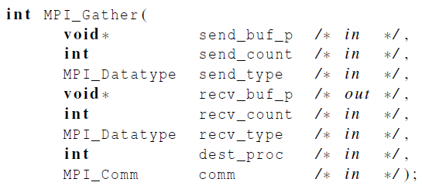
Gather
Collect all of the components of the vector onto process 0, and then process 0 can process all of the components.
You can think about it as the inverse for MPI_Scatter
  Instead of spreading elements from one source to many receivers, MPI_Gather takes elements from Many Sources and gathers the to one single process
FX prototype is the same as SCATTER
Only the root process needs to have a valid buffer, any other calling process can pass NULL the receiving buffer
Copyright © 2010, Elsevier Inc. All rights Reserved

Slide 14

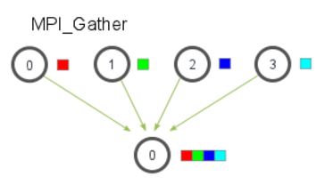
Gather (visual explanation)
Copyright © 2010, Elsevier Inc. All rights Reserved

Slide 15
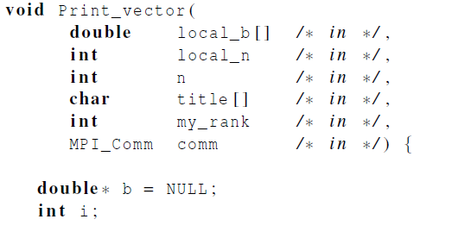
Print a distributed vector (1)
Copyright © 2010, Elsevier Inc. All rights Reserved

Slide 16
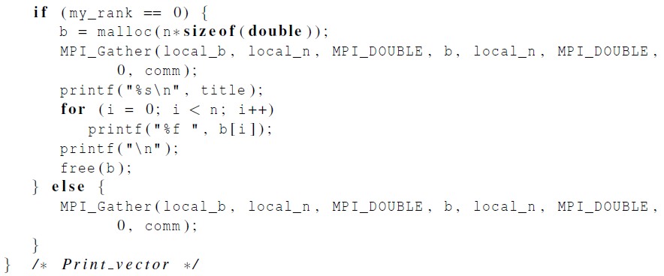
Print a distributed vector (2)
Copyright © 2010, Elsevier Inc. All rights Reserved

Slide 17
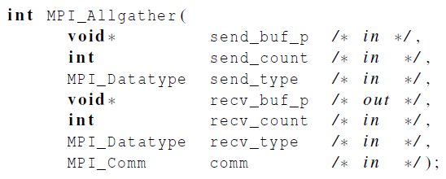
Allgather
Concatenates the contents of each process’ send_buf_p and stores this in each process’ recv_buf_p.
As usual, recv_count is the amount of data being received from each process.
Copyright © 2010, Elsevier Inc. All rights Reserved

Slide 18
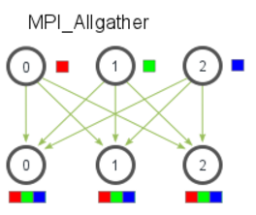
Allgather (visual explanation)
Copyright © 2010, Elsevier Inc. All rights Reserved

Slide 19
Stop, lets review this
MPI_Reduce +
MPI_Bcast
→ MPI_AllReduce
MPI_Gather +
MPI_Bcast
→ MPI_Allgather
Copyright © 2010, Elsevier Inc. All rights Reserved

Slide 20

MPI_Barrier
Ensures that no process will return from calling it until every process in the communicator has started calling it.
Copyright © 2010, Elsevier Inc. All rights Reserved

Slide 21
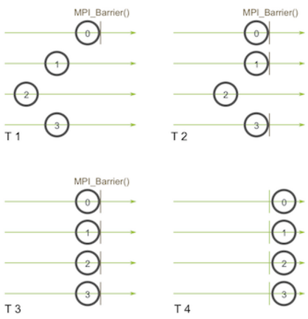
MPI_Barrier (visual explanation)
Copyright © 2010, Elsevier Inc. All rights Reserved

Slide 22
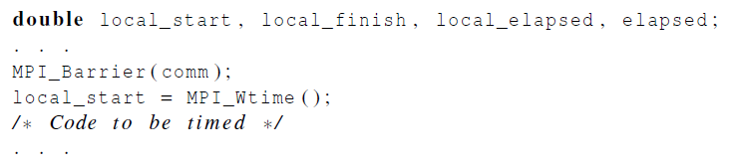
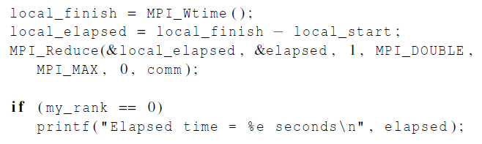
MPI_Barrier
Copyright © 2010, Elsevier Inc. All rights Reserved

Slide 23
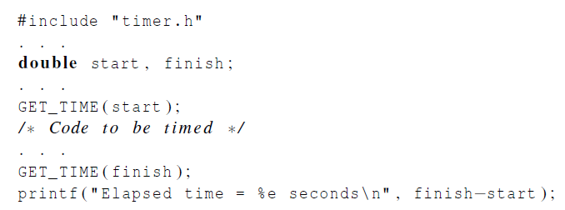
Elapsed serial time
Example 1
(Students: Is this giving you secs or something else?)
Example 2
(Students: Play with this)
Copyright © 2010, Elsevier Inc. All rights Reserved

Slide 24
Elapsed Parallel time
MPI_Wtime
Returns an elapsed time on the calling processor Synopsis
double MPI_Wtime( void )
Return value
Time in seconds since an arbitrary time in the past.
Notes: This is intended to be a high-resolution, elapsed (or wall) clock. See MPI_WTICK to determine the resolution of MPI_WTIME. If the attribute MPI_WTIME_IS_GLOBAL is defined and true, then the value is synchronized across all processes in MPI_COMM_WORLD.
Copyright © 2010, Elsevier Inc. All rights Reserved

Slide 25
Students
Play with these instructions, make sure that you review the material and understand each concept.
  Scatter
  Gather
  Allgather
  Barrier
  Wtime
  Any other explain previously
Copyright © 2010, Elsevier Inc. All rights Reserved

